Slide 1
MVSNet: Depth Inference for
Unstructured Multi-view Stereo
Soorya Boopal
Meenakshisundaram Ganapathi
Dheeraj Chilukuri

Slide 2
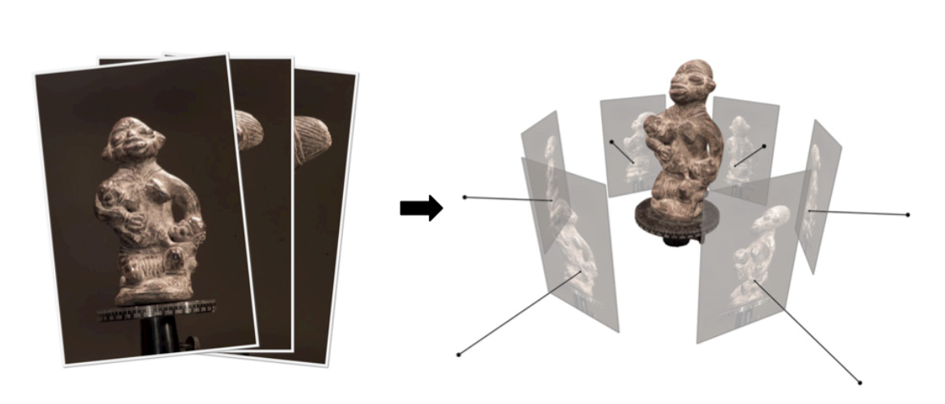
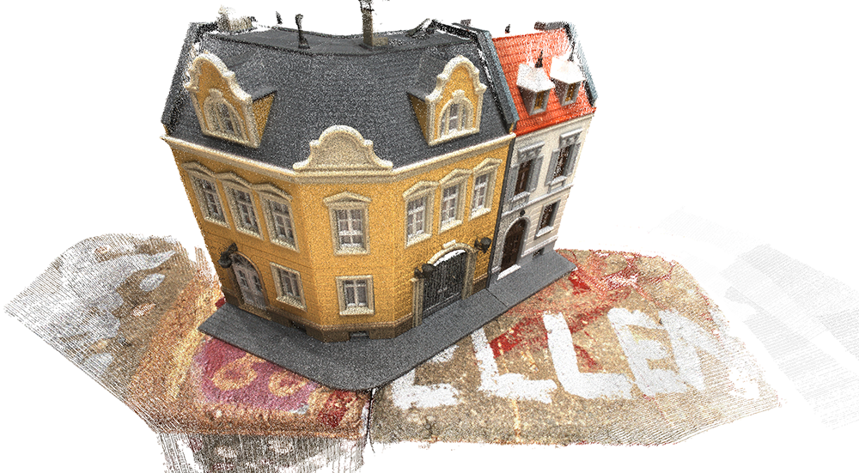
Problem Definition
Problem Statement
Accurate 3D scene reconstruction from multiple unstructured images remains challenging due to occlusions, varying depth ranges, and high-resolution scene requirements.
Impact
Improving multi-view stereo (MVS) pipelines directly benefits areas such as autonomous navigation, robotics, augmented reality, and digital preservation by enabling reliable and dense 3D reconstructions.

Slide 3
Related Work
MVS Methods
Point Cloud-Based
Volumetric-Based
Depth Map-Based
Parameters | Traditional Stereo | Modern Stereo | SurfaceNet | MVSNet
Feature Extraction | Handcrafted | CNN-based | CNN-based | CNN-based
Cost Volume | 2D disparity map | 3D cost volume | 3D voxel grid | Depth-wise 3D
Input Views | Stereo pair | Stereo pair | Multiple unstructured views | Multiple unstructured views
Output | Disparity map | Disparity map | Voxel-based surface occupancy | Depth maps or 3D point cloud

Slide 4
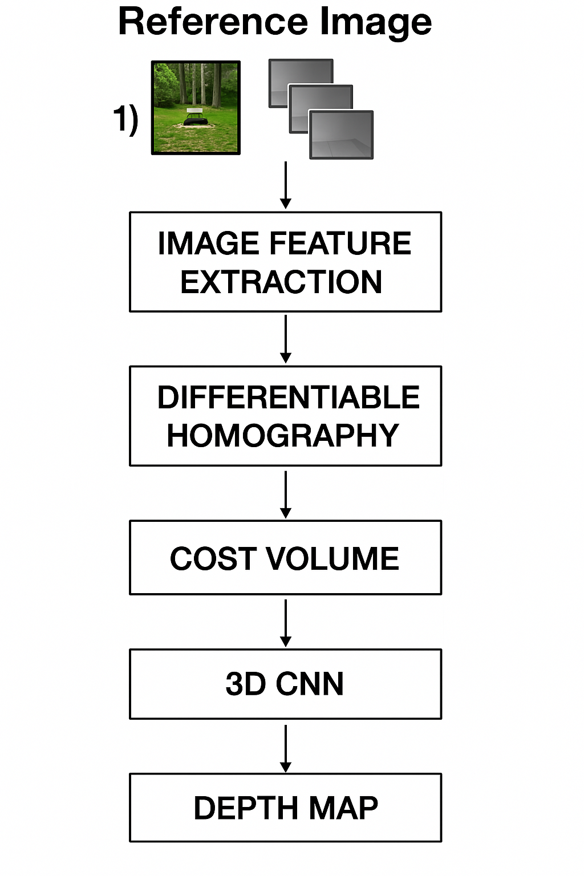
Background
What is Multi-View Stereo (MVS)?
Reconstructs 3D geometry from multiple overlapping images. Core Concepts for MVSNet
• Reference & source images for per-view depth estimation. • Camera geometry & differentiable homography warping . • 3D cost volume built from warped features. • 3D CNN regularization for smooth, reliable depth predictions. • Soft argmin for sub-pixel depth regression.

Slide 5
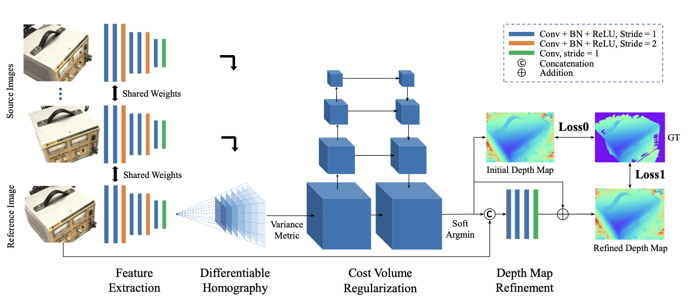
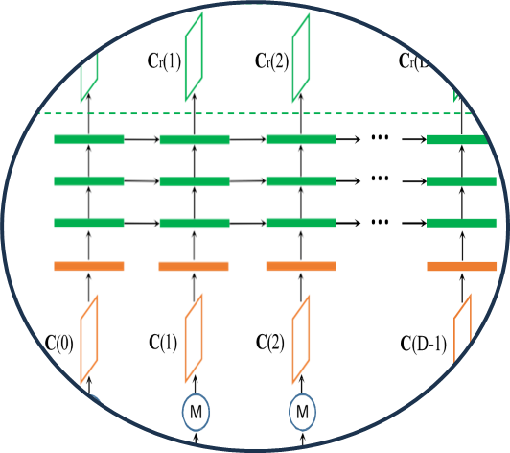
Methodology
MVSnet
Recurrent Regularization

Slide 6

Results
Metric | Our Training (MVSNet) | Paper (MVSNet) | Our Training (Recurrent MVSNet)
Accuracy (mm) | 0.426 | 0.396 | 0.388
Completeness (mm) | 0.552 | 0.527 | 0.493
Overall Quality (mm) | 0.489 | 0.462 | 0.441
F-score (<1mm) | 72.31% | 75.69% | 77.35%
F-score (<2mm) | 78.92% | 80.25% | 82.47%
Time per scan (s) | 245 | 230 | 167
Time per view (s) | 5.2 | 4.7 | 3.1

